Slide 1
Sensitive Data Leakage Detection Based on Vision-Language Models
Yuval Dahan
Ron Shuster
Erik Idelchik

Slide 2
Project Goals & Main Challenge
Goals:
Fine-tune Vision-Language Model (VLM) to detect sensitive data leaks in visual + textual documents.
Build a system that classifies documents as sensitive or non-sensitive.
Classify sensitive documents into specific types of sensitive data(e.g. credit card, SSN…)
Evaluate how well the model performs in realistic, real-world scenarios.

Slide 3
Methodology Overview
1️⃣ Dataset Collection & Creation:
Use Faker Library and scripts to generate realistic sensitive and non-sensitive document images with matching text, along with gathering sensitive information available across the web.
2️⃣ Preprocessing:
Normalize formats and store annotations in structured JSON format.
3️⃣ Model Training (Qwen2.5-VL-7B + LoRA, BLIP-2 + LoRA): Fine-tune two vision-language models – Qwen2.5-VL-7B-Instruct and BLIP-2 (Flan-T5-XL) – using Low-Rank Adaption (LoRA). Both follow the same JSON schema and evaluation setup for fairness.
4️⃣ Caption Comparison & Analysis: Compare outputs from base and fine-tuned models (both Qwen2.5 and BLIP-2) to evaluate learning progress, sensitivity detection, and trade-offs between architectures.

Slide 4
Dataset
Total: 42,000 (used only 12,000 for training due to hardware limitations).
Format: JSONL with image-text pairs
Sensitive data examples:
Credit Cards
Medical Letters
Phone Bills
Driver license
Non-Sensitive data examples:
Advertisements
Scientific reports
Generic Emails
For dataset examples: URL

Slide 5
Intermediate Results
Fine-Tuned Model:
Qwen2.5-VL-7B-Instruct + LoRA
BLIP-2 (Flan-T5-XL) + LoRA
(Both trained with frozen base weights and lightweight adapters for a fair comparison.)
Dataset:
Train: 8,000 (4k sensitive / 4k non-sensitive)
Validation: 2,000 (1k / 1k)
Test (internal): 2,000 (1k / 1k)
External evaluation: 2,000 images unrelated to the training process
Training Machine:
GPU: NVIDIA A100 with 80 GB VRAM
12 vCPUs
RAM: 90 GiB system memory
Training Time: ~24 Hours per model

Slide 6
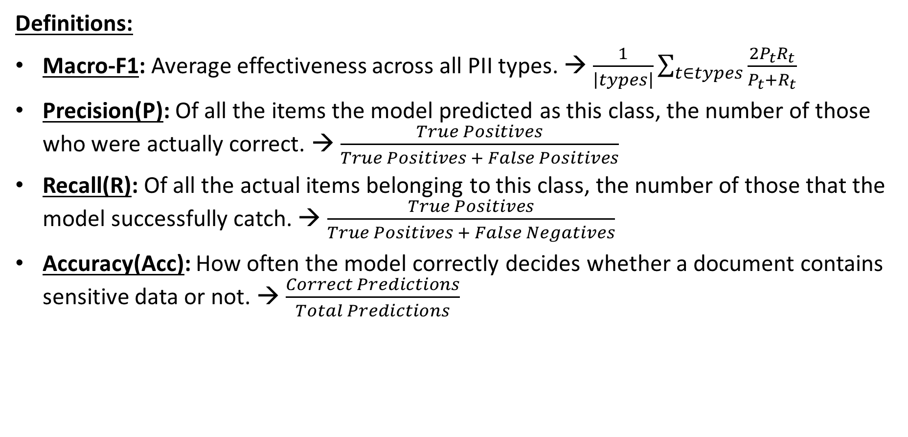
Intermediate Results
Definitions:
Macro-F1: Average effectiveness across all PII types. → $\frac{1}{\left|types\right|}\sum_{t∈types}{\frac{2P_{t}R_{t}}{P_{t}+R_{t}}}$
Precision(P): Of all the items the model predicted as this class, the number of those who were actually correct. → $\frac{True Positives}{True Positives + False Positives}$
Recall(R): Of all the actual items belonging to this class, the number of those that the model successfully catch. → $\frac{True Positives}{True Positives + False Negatives}$
Accuracy(Acc): How often the model correctly decides whether a document contains sensitive data or not. → $\frac{Correct Predictions}{Total Predictions}$

Slide 7
Intermediate Results
Training Summary:
Qwen 2.5-VL-7B-Instruct and BLIP-2 fine-tuned with LoRA to detect sensitive data and recognize PII (Personally Identifiable Information) types from images.
Model is prompted to return JSON labels (true/false per class).
Instead of training all the parameters of the base model (Qwen 2.5-VL or BLIP-2) and update the whole model, we used LoRA adapters.
That means only small add-on layers were trained while the big model stayed frozen.
This makes training much lighter and faster but still lets the model learn how to recognize our PII classes.

Slide 8
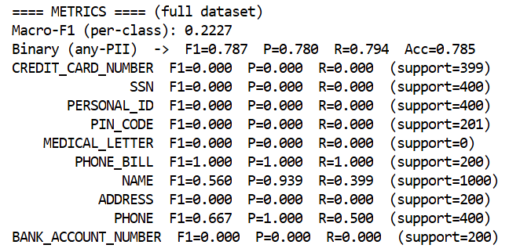
Intermediate Results
Base model “BLIP-2” results:
Macro-F1 (per-class): 0.2227
Classification (sensitive/non-sensitive):
F1 = 0.787
Precision = 0.780
Recall = 0.794
Accuracy = 0.785 (78.5%)
BLIP-2 base shows strong recall and precision for a few classes (Phone Bill, Phone, Name), but misses others like Credit Card, SSN, and Address. It is limited in per-class coverage.

Slide 9
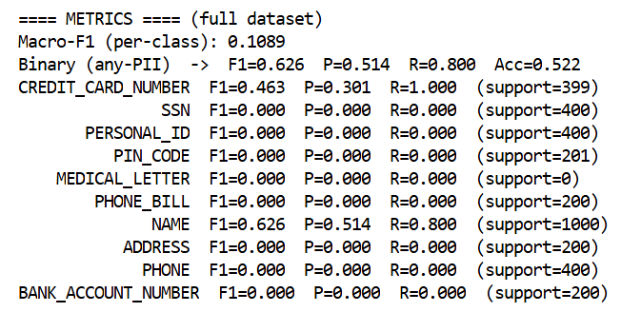
Intermediate Results
BLIP-2 + LoRA results:
Macro-F1 (per-class): 0.1089
Classification is weaker compared to the base
model due to very low per-class coverage.
Classification (sensitive/non-sensitive):
F1 = 0.626
Precision = 0.514
Recall = 0.800
Accuracy = 0.522 (52.2%)
Most classes scored 0 in this evaluation
Only Credit Card Number and Name showed non-zero performance.

Slide 10
Intermediate Results
Analysis:
Both models keep recall high, but Base BLIP-2 has much better balance and higher precision, with far fewer false positives.
LoRA improves Credit Card and Name recall, but at the cost of flooding with false positives.
Conclusion:
Base BLIP-2 better for general detection.
LoRA useful when credit card detection is the priority.
The BLIP-2 model proved unsuitable for reliable sensitive data detection, which led us to explore stronger alternatives.
Therefore, we transitioned to Qwen 2.5-VL-7B-Instruct model.

Slide 11
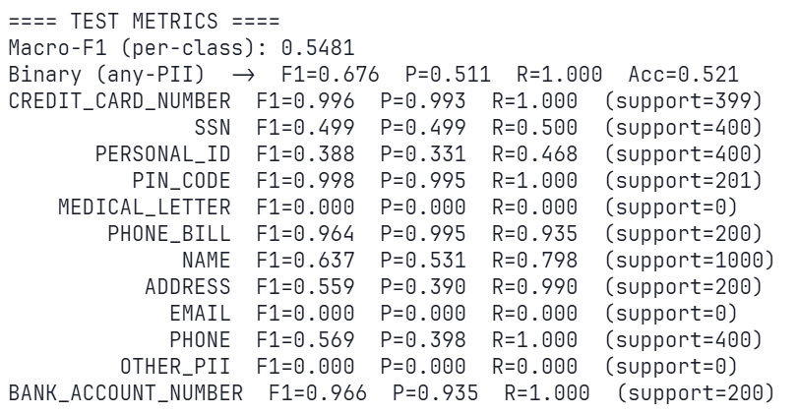
Intermediate Results
Base model “Qwen2.5-VL-7B-Instruct” results:
Macro-F1 (per-class) with 0-support classes: 0.5481
Macro-F1 (per-class) without 0-support classes: 0.7306
Classification (sensitive/non-sensitive):
F1 = 0.676
Precision = 0.511
Recall = 1
Accuracy = 0.521 (52%)
* No support in this evaluation for:
MEDICAL_LETTER, EMAIL, OTHER_PII
(As a result, the scores for these types are 0, which
Lowers the Macro-F1).

Slide 12
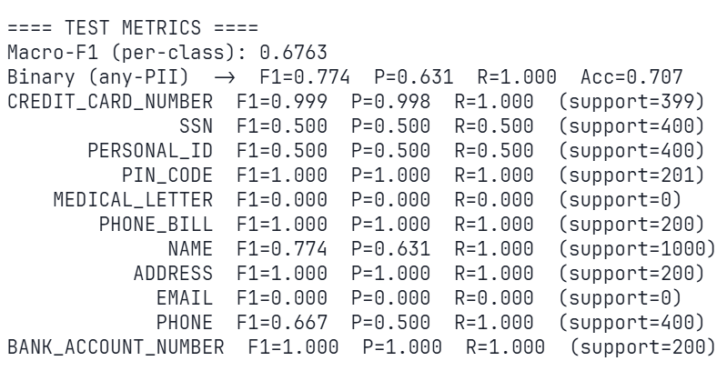
Intermediate Results
Qwen2.5-VL-7B-Instruct + LoRA results:
Macro-F1 (per-class) with 0-support classes: 0.6763
Macro-F1 (per-class) without 0-support classes: 0.8266
Classification (sensitive/non-sensitive):
F1 = 0.774
Precision = 0.631
Recall = 1
Accuracy = 0.707 (70%)
* No support in this evaluation for:
MEDICAL_LETTER, EMAIL
(As a result, the scores for these types are 0, which
Lowers the Macro-F1).

Slide 13
Intermediate Results
Analysis:
The hardest categories are SSN, PERSONAL_ID:
1) SSN - No real change, still weak at 0.500.
2) PERSONAL_ID – Noticeable bump (0.388 → 0.500), but still low, meaning LoRA teaches the model better decision boundaries and cutting false alarms, but it’s underperforming.
Numeric/structured PII (credit cards, PINs, bank accounts) was already strong and stays perfect or near perfect.
Recall = 1 in both models, but precision increases after fine-tuning → safer, more actionable alerts from the model regarding Sensitive data.

Slide 14
Intermediate Results
Analysis:
Accuracy:
* Since Recall = 1, Qwen2.5-VL-7B-Instruct (base model) catch all sensitive images. Therefore the base model wrongly flags ~958/1000 non-sensitive images (Precision 0.511).
Only ~42 non-sensitive images are correctly identified → Acc = 0.521
* Since Recall = 1, Qwen2.5-VL-7B-Instruct + LoRA (fine-tuned model) catch all sensitive images.
Therefore the fine-tuned model wrongly flags ~586/1000 non-sensitive images (Precision 0.631).
~414 non-sensitive images are correctly identified → Acc = 0.707

Slide 15
Intermediate Results
Analysis:
Because recall is already 1 in both models, the accuracy gain is entirely due to better selectivity on non-sensitive images.
This leads to +18.6 percentage-point jump, this is real improvement.
Overall:
LoRA stabilized strong classes (credit card, PIN, bank account number), gave big boosts to weak ones (address, personal ID, phone), but SSN is still problematic.

Slide 16
Intermediate Results
Summary:
Fine-tuned two VLMs: BLIP-2 and Qwen2.5-VL-7B, both with LoRA adapters.
BLIP-2 showed limited per-class coverage → not suitable for reliable detection.
Qwen2.5-VL-7B + LoRA delivered strong performance:
Perfect recall (1.0) on sensitive data.
Higher precision and accuracy, reducing false alarms.
Demonstrated that lightweight fine-tuning can make VLMs useful for protecting privacy and following compliance rules.

